Slide 1
NewRocket - Boeing POC
Tuesday, 4 November, 2025

Slide 2
Today’s Agenda
Skill: Chat Summarization
Skill: Sentiment Analysis and Trend
Agent: Elara, with Boeing-specific use cases implemented.
Agent: Phoebe, with Boeing-specific use cases implemented.

Slide 3

Your first skill: Chat Summarization
Boeing process can start with an Agent – User/Customer chat. NewRocket is implementing the following use cases to enhance the chat experience, saving the Agent time and clicks!
Key Capabilities enabled for Boeing POC
Use case #1
When an Agent types /summarize in the chat window, a summary of the chat is generated and shown to the Agent
Use case #2
When an Agent closes the chat, a summary of the chat is copied to the Chat summary field of the interaction
Use case #3
When an Agent accesses an interaction containing a chat summary in the Service Operation Workspace, using the button "Create incident“ the chat summary contained in the interaction is copied to the Description Field of the incident with the title "Chat Summary:" preceding the chat

Slide 4

Acceptance Criteria for Chat Summarization Use Cases
I know this is complete when:
When I type /summarize in a chat window, a summary of the chat is shown to me
When I am chatting with a requester and I close the chat, a summary of the chat is copied to the Chat summary field of the interaction
When I select the button "Create incident" button from an interaction containing a chat summary, in the Service Operation Workspace, the chat summary is copied to the Description Field of the incident with the title "Chat Summary:"

Slide 5
DEMO: Chat Summarization

Slide 6

Meet Elara – Boeing’s New Knowledge Management Orchestrator
As the intelligence behind Knowledge Management, Elara can automate creation, enrichment, governance, and archival integrating seamlessly with ServiceNow to maintain a dynamic, reliable knowledge base across the enterprise.
Key Capabilities enabled for Boeing POC
Use case #1 – Overlap with Chat Summarization Skill
End user starts a chat from a KB, and interacts with agent.
Agent opens an Incident and closes Chat.
Use case #2
End user starts an Incident from a KB and Agent uses “Create Knowledge Gap”.
No new article is created when KB ID already populated.
Use case #3
End user starts an Incident from a KB and Agent uses “Create Knowledge Gap”
A new article created if no KB ID populated.
NewRocket has one client reporting 70 articles per month being created; 50 get approved.

Slide 7
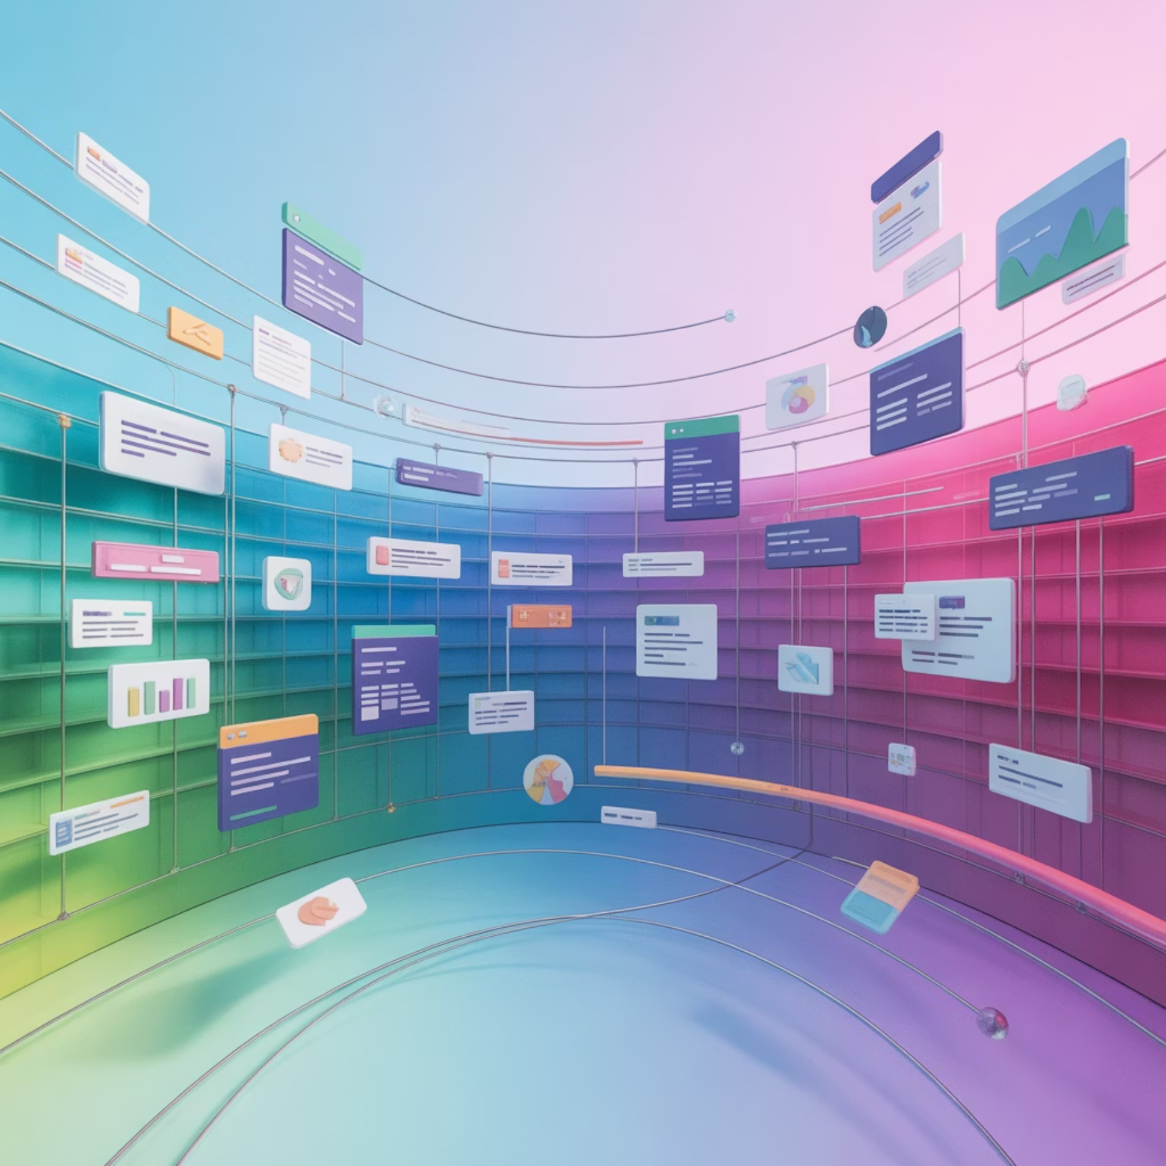
Elara’s Business Value and Impact
Driving measurable efficiency and trust through autonomous knowledge orchestration.
Autonomous Knowledge Creation
Automatically generates high-quality knowledge articles from resolved incidents, ensuring valuable solutions are captured without manual effort.
Intelligent Content Enrichment
Augments internal knowledge by automatically researching and incorporating relevant information from trusted external web sources.
AI-Powered Content Governance
Enforces brand voice, tone, and style consistency across all knowledge articles, and uses AI to suggest structural improvements for better readability.

Slide 8

Acceptance Criteria for Elara Use Cases
I know this is complete when:
Elara creates knowledge articles from opened KFT records when "Report Knowledge Gap" is selected on the incident form.
When evaluating a KFT, Elara confirms there are no other open KFTs with the same incident.
Elara creates articles in the AnswerIT knowledge base based on Boeing's existing structured content, populating End-User and Agent1 fields where appropriate.
Articles created by Elara attempt to complete fields in the IT Business Data tab wherever possible, recognizing the approval process requirements.
All articles created by Elara follow Boeing's standard approval process.

Slide 9
DEMO: Elara – Knowledge Management

Slide 10

Meet Phoebe – Boeing’s New IT Service Orchestrator
Phoebe is the core agent leading a dedicated team of specialized helper agents for IT Service Management, providing instant, automated resolutions that transform the user experience and free up valuable support capacity.
Key Capabilities enabled for Boeing POC
Use case #1 – New Incident
On newly opened incidents, Phoebe suggests relevant knowledge and fills the KB field, therefore filling fields into the incident.
Use case #2 – Incident was resolved but re-opened by requester
On incident state change from Resolved to In progress, Phoebe will:
Analyze resolution notes, any additional comments added
Engage with the requester, providing further help
If the result of the conversation is deemed to be a new incident, Phoebe will close the current incident and open a new one automatically
If the result of the conversation is deemed to be the same issue as the current incident, Phoebe leaves the incident in progress and assigned to its original assignee

Slide 11
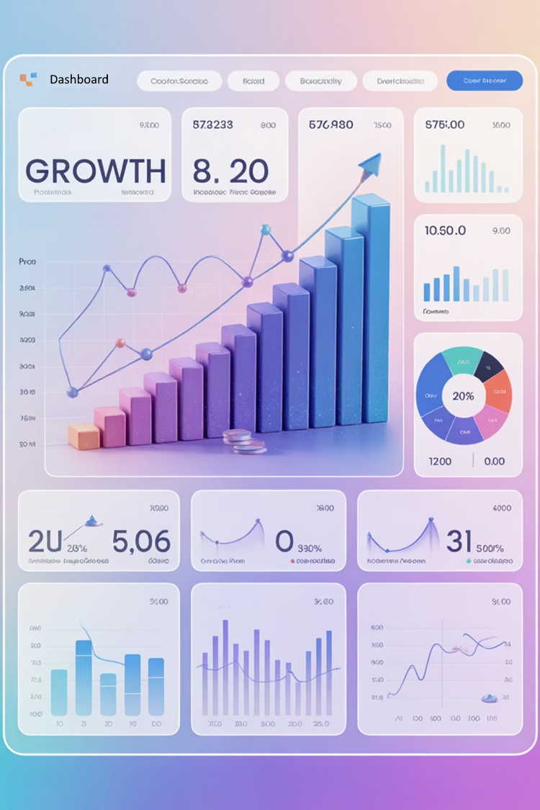
Phoebe’s Business Value and Impact
Driving faster resolutions and smarter service through autonomous IT support.
Improve First-Contact Resolution
Increase first-contact resolution rates by empowering agents with the right information and automating repetitive tasks.
Reduce Ticket Volume
Proactively deflect inbound incidents and service requests by providing instant, automated resolutions through self-service channels.
Lower IT Support Costs
Reduce cost per ticket and lighten the load on service desk staff by automating Tier 1 and Tier 2 support activities.

Slide 12
Acceptance Criteria for Elara Use Cases
I know this is complete when:
On newly opened incidents, Phoebe pulls relevant knowledge and fills the KB field, therefore filling fields into the incident
On incident state change from Resolved to In progress, Phoebe should:
Analyze resolution notes, any additional comments added
Engage with the requester, providing further help
If the result of the conversation is deemed to be a brand new incident, Phoebe should close the current incident and open a new one automatically, Phoebe will not wait for confirmation from the requester
If the result of the conversation is deemed to be the same issue as the current incident, Phoebe, leaves the incident in progress and assigned to its original assignee.

Slide 13
DEMO: Phoebe – Incident Management

Slide 14

Wrap Up
This Photo by Unknown Author is licensed under CC BY-SA-NC

Slide 15


Thank You
The AI-first ServiceNow® Elite Partner
October 22, 2025

